Slide 1
CaaS
AKS Guidelines
March 2022

Slide 2
AKS Introduction

Slide 3
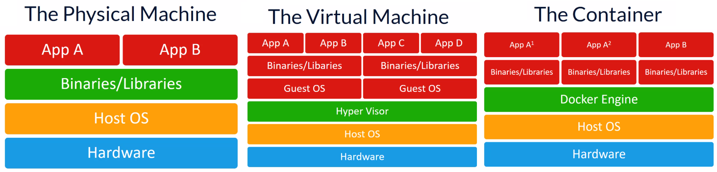
Introduction (Container & Docker)
Docker is a tool designed to make it easier to create, deploy, and run applications by using containers.
Containers allow a developer to package up an application with all of the parts it needs, such as libraries and other dependencies, and deploy it as one package.
There advantages of Docker & Container compared to Virtual machines include:
Small: There relative memory footprint is small compared to a VM
Fast: They don’t need to boot the whole operating system like a VM
Portability: The image can be moved to run in the Container runtime on premises or in the cloud
Resource governance: A container can limit the physical resources that it can consume on its host.
Docker Editions - Docker CE is a free and open source containerization platform. Docker EE is Docker CE with certification on some systems and support by Docker Inc.

Slide 4
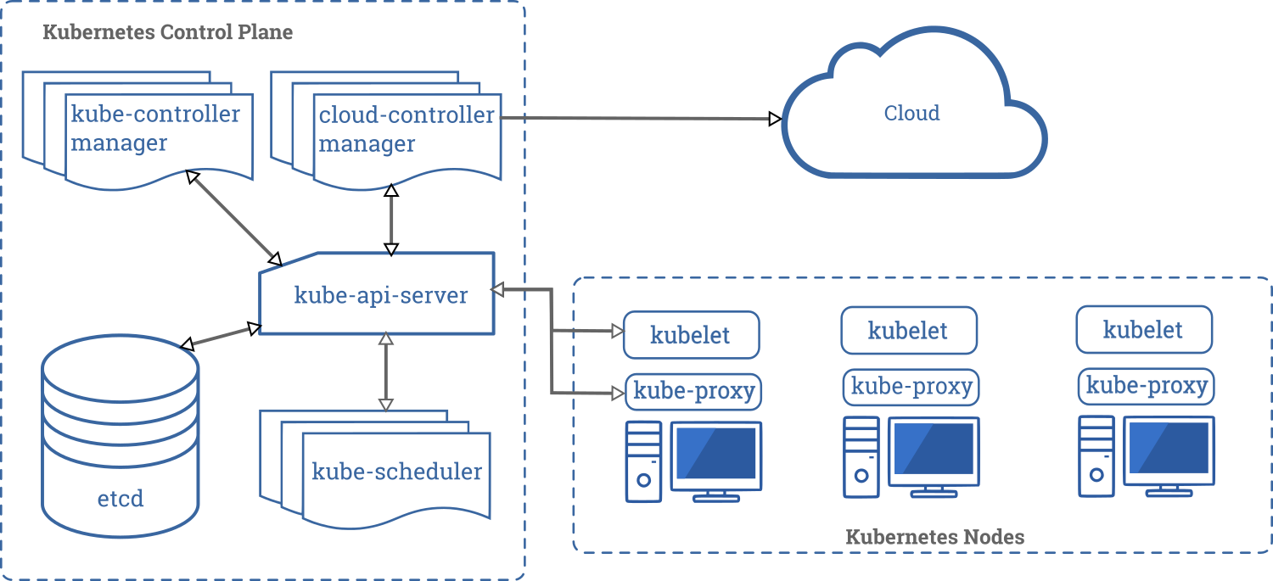
K8S Intro & Architecture
K8s & AKS Introduction
Kubernetes is an open-source container orchestration system for automating software deployment, scaling, and management.
Azure Kubernetes Service (AKS) is a managed container orchestration service based on the open source Kubernetes system, which is available on the Microsoft Azure public cloud
.
Service | Port | Direction | Node Type | Used By
Kubernets API Server | 6443 | Inbound | Maser Node | All
etcd server client API | 2379 - 2380 | Inbound | Maser Node | Kube-apiserver, etcd
Kubelet API | 10250 | Inbound | Maser Node | Self, Control Plane
kube-scheduler | 10251 | Inbound | Maser Node | Self
kube-controller manger | 10252 | Inbound | Maser Node | Self
Kubelet API | 10250 | Inbound | Worker node(s) | Self, Control Plane
NodePort Services | 30000-32767 | Inbound | Worker node(s) | All

Slide 5
AKS Namespace & Cluster Topology

Slide 6
AKS Cluster
In Azure the first step of deployment is configuring the AKS Cluster. AKS Cluster will have Managed Master Node, Worker Nodes, Advanced networking, Azure Active Directory (Azure AD) integration, monitoring, and other features.
Managed Kubernetes cluster in Azure offloads the operational overhead to Azure. As a hosted Kubernetes service, Azure handles critical tasks, like health monitoring and maintenance of the Master Node. Since Kubernetes masters are managed by Azure, we only manage and maintain the agent nodes.
Standard Cluster – A standard AKS cluster provides a public IP address for the API server.
Private Cluster - A private AKS cluster, on the other hand, will use a private IP address for its API server endpoint. This enables traffic between Node pools and API server to be only on private network. Private Clusters have the additional requirement of creating Private Endpoint

Slide 7



AKS Standard cluster
IP :10.0.0.1
Worker Node 1
aks-link
kubectl
Etcd
Public Endpoint
20.12.147.52
IP :10.0.0.2
Worker Node 2
Control Plane
Scheduler
aks-link
kubectl
API Server
IP :10.0.0.3
Worker Node 3
aks-link
kubectl
Azure Managed
Customer Managed
SSH
VPN
TCP
Cluster Admins
kubectl
Internet

Slide 8


AKS Private cluster
IP :10.0.0.1
Worker Node 1
kubectl
Etcd
Private Link
Private Endpoint
10.0.0.10
IP :10.0.0.2
Worker Node 2
Control Plane
Scheduler
kubectl
API Server
IP :10.0.0.3
Worker Node 3
kubectl
Jump Server
Azure Managed
Customer Managed
Cluster Admins
kubectl
Internet

Slide 9
Difference between Environment base Cluster and Grouped one
Topics | AKS Cluster for each application | AKS Cluster for Each Business Group | AKS Cluster Per Environment
Description | Each application can manage their own AKS Cluster | AKS Cluster to be shared between all applications of a Business Group. Individual applications and related components will be deployed in dedicated namespaces | Common AKS cluster for all containerized applications in abrdn per environment. Individual applications and related components will be deployed in dedicated namespaces
Provisioning and management overhead | High - Cluster creation, maintenance and governance challenges will grow | Medium | Low - Initial deployment is one time job Maintenance can be managed centrally
Define/classify Cluster property | Easy - Each application cluster can have different property | Medium – For each Business we need to define the Property | Complex – Need to derive the common properties and setup for all application
Cluster Sizing - Calculate CIDR, VM Size & Count, etc. | Easy – Its per Application so easy to derive. | Medium - Sizing can be managed | Complex – Cluster resource limits will be hit much sooner.
Security - IAM & RBAC | Separate RBAC for each application | RBAC can be managed on namespaces | RBAC can be managed on namespaces
Cost efficient | Low - Increased cost | Medium - Balanced cost | High - Optimal cost
Resource Utilization | Low - Under utilization of resources | Medium - Effective resource utilization | High - Maximum resource utilization
Introduce Changes & Maintenance to Cluster | Low risk, if any cluster has issues only those applications will be impacted | Medium Rollout and rollback process. Easy to derive Maintenance/patching window. | Complex Rollout and rollback process. Maintenance/patching nightmare with hard-to-get acceptable window.
Costs show back | Each App have its cluster so easy to calculate the cost for the App. | Costs show back for individual Business vector is possible | Cost show back will be difficult
Performance & Capacity Management | No resource sharing so no bottleneck | Need to
Repo Management | Easy and high Security | Medium - Balanced | Complex on Managing & securing
Use Case | Suits for minimum number of applications | Suits for Medium or largescale application, Business group isolations | Its suites for large number of applications migrating to Microservices

Slide 10
Cluster Namespace
Namespaces are a way to organize clusters into virtual sub-clusters, it can be helpful when different teams or projects share a Kubernetes cluster. Any number of namespaces are supported within a cluster, each logically separated from others but with the ability to communicate with each other. Namespaces cannot be nested within each other
Isolation - Large or growing teams can use namespaces to isolate their projects and microservices from each other. Teams can re-use the same resource names in different workspaces without a problem. Also, taking an action on items in one workspace never affects other workspaces.
Organization - Organizations that use a single cluster for development, testing, and production can use namespaces to sandbox dev and test environments. This ensures production code is not affected by changes that developers or testers make in their own namespaces throughout the application lifecycle.
Permissions - Namespaces enable the use of Kubernetes RBAC, so teams can define roles that group lists of permissions or abilities under a single name. This can ensure that only authorized users have access to resources in a given namespace.
Resource Control - Policy-driven resource limits can be set on namespaces by defining resource quotas for CPU or memory utilization. This can ensure that every project or namespace has the resources it needs to run, and that no one namespace is hogging all available resources.
Performance - Using namespaces can help improve performance of a given cluster. If a cluster is separated into multiple namespaces for different projects, the Kubernetes API will have fewer items to search when performing operations. This can reduce latency and speed overall application performance for each application running on the cluster.

Slide 11
AKS Namespace RBAC Diagram
Namespace 1
Namespace 2
Services
Services
Admin
IP Address
IP Address
POD 1
POD 2
User 1
POD 1
POD 2
User 2

Slide 12


AKS Cluster & Namespace Sample Topology
Non-Production
Production
Development
Test
Stage
Business Unit 1
Business Unit 2
Namespace 1
Namespace 2
Namespace 1
Namespace 2
Namespace 1
Namespace 2
Namespace 1
Namespace 2
Namespace 1
Namespace 2
App 1
App 2
App 1
App 2
App 1
App 2
App 1
App 2
App 1
App 2

Slide 13
AKS Basic Components

Slide 14
AKS Networking

Slide 15
AKS Networking Guidelines
Topics covered
Networking Models –
Azure CNI : Azure CNI is a vendor-neutral protocol that lets the container runtime make requests to a network provider. It assigns IP addresses to pods and nodes, and provides IP address management (IPAM) features as you connect to existing Azure virtual networks.
Kubenet : Nodes and pods are placed on different IP subnets, User Defined Routing (UDR) and IP forwarding routes traffic between pods and nodes.
Network Policy Types
Azure Network Policies : Azure's own implementation of policies
Calico Network Policies : An open-source network and network security solution founded by Tigera

Slide 16
Pod Connectivity ( Kubenet )
AKS Virtual Network (10.220.0.0/16)
Pod Outbound
Traffic Type | Source | Destination | Description
Pod-Pod (Same VM) | Pod 1 | Pod 2 | The packets reaches destination directly with no UDR as the pod resides in the same node
Pod-Pod (Other VM) | Pod 1 | Pod 4 | The packets uses UDR to reach destination as Pod4 resides in Node 2
Pod-VM (Same Cluster Network) | Pod 1 | VM1 | Pod1 can access VM1, VM1 sees Node IP of Pod1 as source IP (SNAT)
Pod-VM (peered or connected Network) | Pod 1 | VM2 | Pod1 can access VM2, VM2 sees Node IP of Pod1 as source IP (SNAT)
AKS Subnet (10.220.1.0/24)
Node 1
Node 2
A logical address space 10.100.0.0/16 would be used across cluster. Each node in cluster gets a /24 block.
Pod 1
10.100.1.1
Pod 2
10.100.1.2
Pod 3
10.100.2.1
Pod 4
10.100.2.2
cbr0
10.100.1.0/24
cbr0
10.100.2.0/24
eth0
10.220.1.6
eth0
10.220.1.7
Destination | Next hop
10.100.1.0/24 | 10.220.1.6
10.100.2.0/24 | 10.220.1.7
UDR - Routing
UDR - Routing
Pod Inbound
Traffic Type | Source | Destination | Description
VM1-Pod | VM1 | Pod 1 | Traffic can’t reach POD as the Pod 1 don’t have routable IP address.
VM2-Pod | VM2 | Pod 1 | Traffic can’t reach POD as the Pod 1 don’t have routable IP address
SNAT
Subnet(10.220.2.0/24)
VM1
Subnet(10.110.1.0/24)
VM2
Peered/On Premise Network (10.110.0.0/16)

Slide 17
Pod Connectivity ( Azure CNI )
AKS Virtual Network (10.220.0.0/16)
Pod Outbound
Traffic Type | Source | Destination | Description
Pod-Pod (Same VM) | Pod 1 | Pod 2 | The packets reaches destination directly with no UDR as the pod is in the same node.
Pod-Pod (Other VM) | Pod 1 | Pod 4 | The packets reaches destination directly as the pod resides in the aks subnet
Pod-VM (Same Cluster Network) | Pod 1 | VM1 | Pod1 can access VM1, VM1 sees Pod 1 IP as the source IP
Pod-VM (peered or connected Network) | Pod 1 | VM2 | Pod1 can access VM2, VM2 sees Node IP of Pod1 as source IP (SNAT)
AKS Subnet (10.220.1.0/24)
Node 1
Node 2
Pod 1
10.220.1.8
Pod 2
10.220.1.9
Pod 3
10.220.1.10
Pod 4
10.220.1.11
azure0
10.220.1.6
azure0
10.220.1.7
eth0
10.220.1.6
eth0
10.220.1.7
Pod Inbound
Traffic Type | Source | Destination | Description
VM1-Pod | VM1 | Pod 1 | Traffic can reach Pod 1 as the Pod 1 has routable IP address.
VM2-Pod | VM2 | Pod 1 | Traffic can reach Pod 1 as the Pod 1 has routable IP address.
Subnet(10.220.2.0/24)
VM1
SNAT
Subnet(10.110.1.0/24)
VM2
Peered/On Premise Network (10.110.0.0/16)

Slide 18
AKS Network Guidelines
Capability | Azure CNI | Kubenet
Multiple clusters in same subnet. | Supported | Not Supported
Performance | Performance is better since the UDR is not used for pod communication | Uses UDR for pod communication, adds extra hop that decreases performance
UDR Management | CNI will not use any UDR so we have full control. Custom Route Table can Map to multiple cluster. | Kubnet create its own rules which cannot be modified we can change only our custom rules. Custom Route Table cannot Map to multiple cluster.
IP Address for Pod | Use the Ips from current Network So Network Requires more IP address space. | Separate CIDR will be used for Pods
Pod-VM connectivity (VM Can be in same or peered of connected Network) | Works both ways | Works when initiated by pod
Support for Windows node pools | Supported | Not Supported
Network Policy | Support Azure Network Policy and Calico | Only Calico Supported
Add Virtual Nodes (eg to Add Azure Container Instance) | Supported | Not Supported
Multiple clusters in same vNET | Supported | Not supported
Maximum Nodes per Cluster | 1000 | 400
Default Maximum Pods per node | 30 (Maximum Pods grow up to 250) | 110 (Maximum Pods grow up to 250)
Suitable use Case | Suitable for complex environment Better network performance is required When we have enough Ips If we need more options and customizations like Windows Support. | Small development or test workloads. Simple websites with low traffic. If required more number of IP addresses which is not supported in current VNet

Slide 19
AKS Network Policy Guidelines
Capability | Azure Network Policy | Calico
Supported platforms | Linux | Linux, Windows Server 2019 (preview)
Supported networking options | Azure CNI | Azure CNI (Windows Server 2019 and Linux) and kubenet (Linux)
Additional features | None | Extended policy model consisting of Global Network Policy, Global Network Set, and Host Endpoint. Calicoctl CLI provides the options to manage the policies.
Support | Supported by Azure support and Engineering team | Calico community support. Additional paid support available from vendor
Logging | Rules added / deleted in IPTables are logged on every host under /var/log/azure-npm.log | All the logs are logged in to /var/log/calico. All logging is done using svlogd.
Use Case

Slide 20
AKS Services & Ingress Controller

Slide 21
AKS Services
Service Component in Kubernetes acts as a cluster interface for PODS by grouping selective set of Pods using Labels and Selectors.
It helps in achieving redundancy during POD Deletion or recreation process
It enables connectivity between different application service / pods or running inside the Kubernetes Cluster
It helps in exposing the applications on POD to networks outside Kubernetes cluster
It helps on Load balancing requests hitting a particular application running on Pods
Three types of services are available
Cluster IP – connect one type of pods with another type of pods (frontend to backend)
NodePort – Node port will work like NAT. Using the Node IP and port this will map to right pod container.
Node port users port from 30000 to 32767
LoadBalancer – send response to all the pods in multiple nodes in round robin.

Slide 22
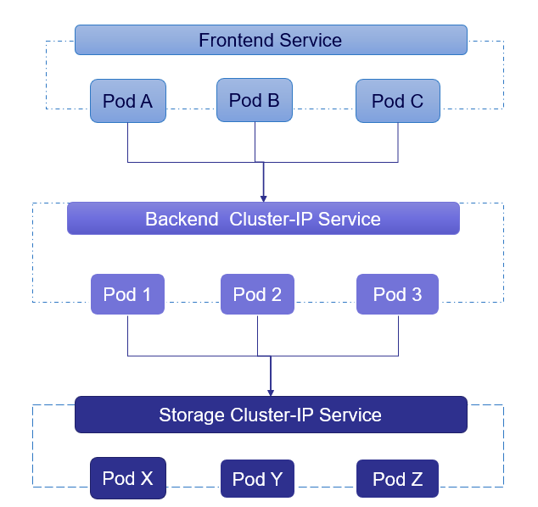
Cluster-IP Service
When Connecting Service within AKS Cluster, A cluster-ip Service can be connected using DNS name of the Service as well.
Below is the syntax
<ServiceName>.default.svc.cluster.local

Slide 23
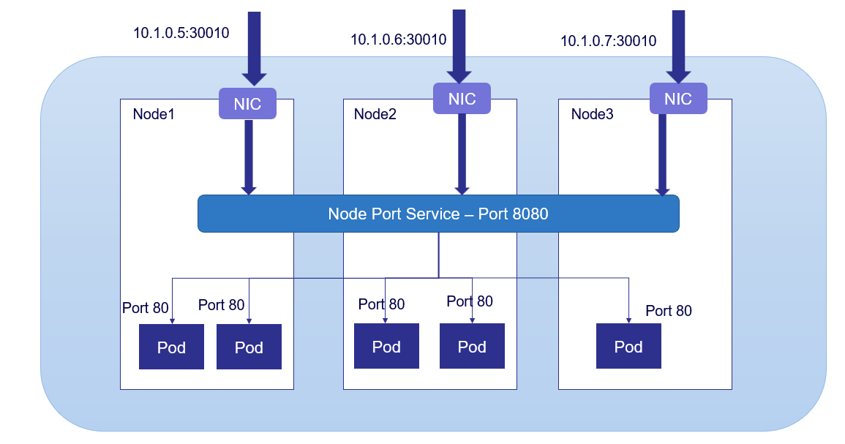
Node-Port Service
Three Type of scenario are available for node Port
Single instance in Single Node – Access with Node IP and Node Port
Multi Instances in single Node – Access with Node IP and Node Port service will redirect to any one
Multi Instances in diff Node – Access with Node IP and Node Port

Slide 24
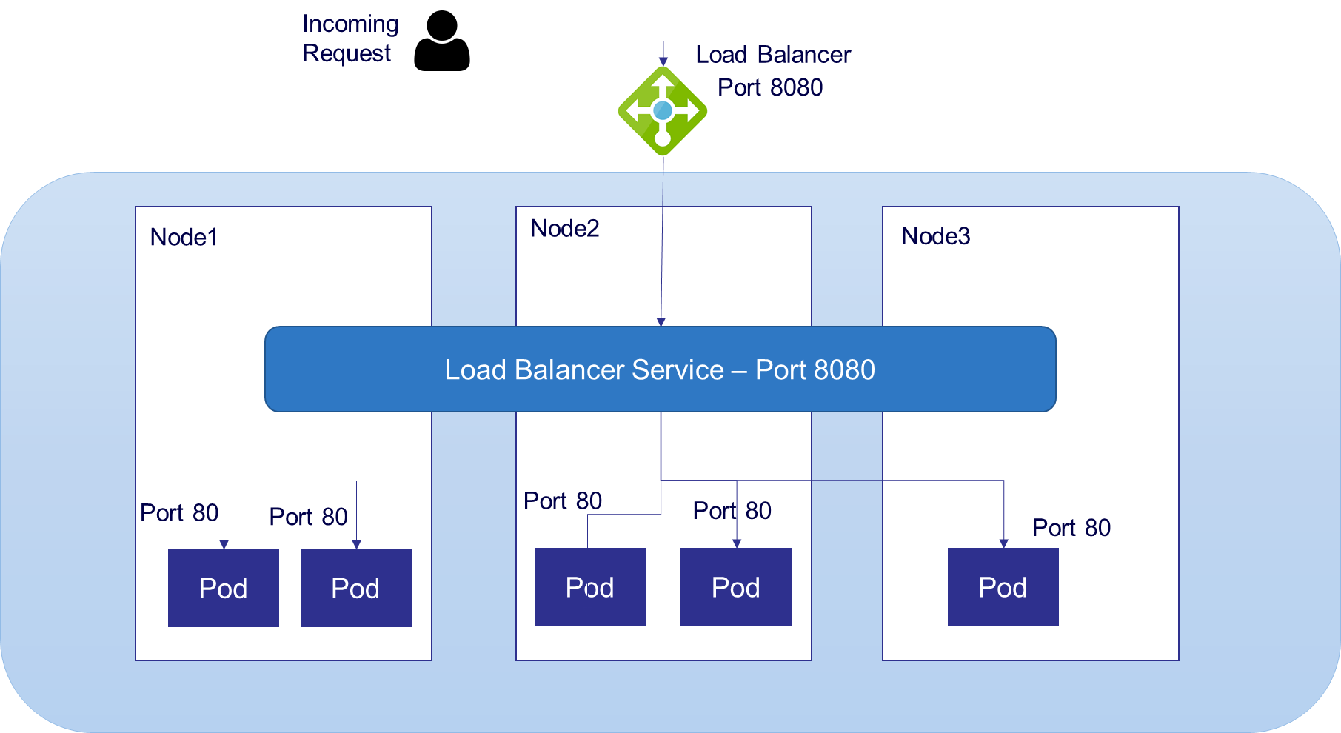
Load Balancer Service

Slide 25
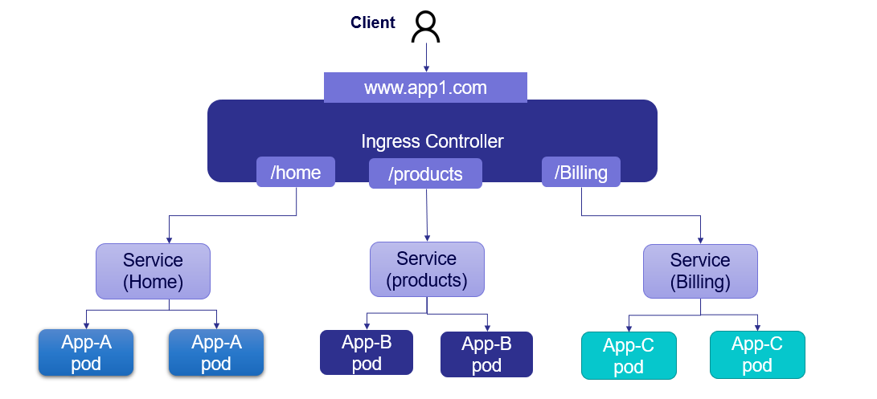
Ingress Controller
Ingress is a collection of rules that allow inbound connections to reach cluster services.
Ingress is configured to expose service through
external URLS
Load Balancer
SSL offloading
It Provides Layer 7 Load balancing features for routing traffic externally to applications hosted on Kubernetes PODS like URL rewrites , path-based routing
.
Ingress is not a deployed in Kubernetes as default. We need to deploy it separately based on the requirements
E.g. – nginx, Azure App Gateway Ingress Controller, Istio etc.

Slide 26
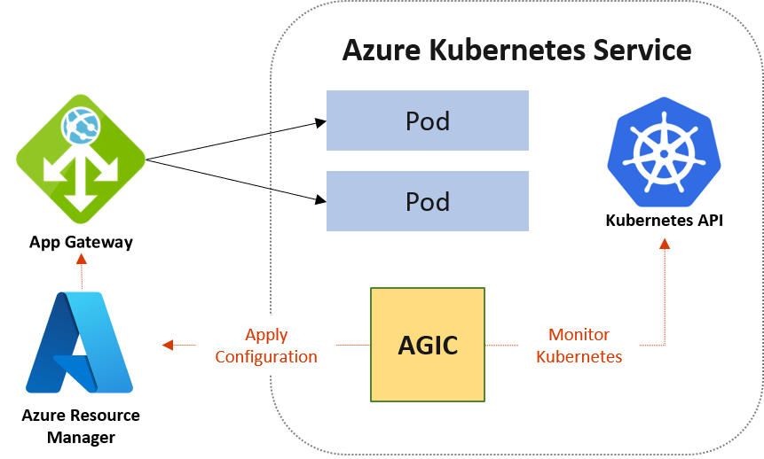
AGIC
Application Gateway talks to pods using their private IP directly and does not require NodePort or KubeProxy services. This also brings better performance to your deployments.

Slide 27
AGIC vs ALB with Nginx
Items | AGIC | Nginx
Definition | Use Azure Application Gateway as the Load Balancing tool This uses Azure Application gateway ingress controller | Use Azure Load balancer as the Endpoint for exposing applications deployed on AKS. This uses Nginx as the Ingress Controller
Provisioning and management overhead | Easy – HA is inbuilt. Provisioning and configuration is simple | Complex setup and configuration compared to AGIC. HA setup add additional work and complexity.
Support | Microsoft Support Available | Microsoft Support Not Available. commercial version can be purchased from F5.
Layer 7 & Layer 4 Support | Only Layer 7. Need to include one more Azure LB for Layer 4 | With out Nginx its layer 4 and with Nginx its Layer 7
Popularity & long in market | Microsoft Native Solution but new to this Area | Nginx is the most widely used Kubernetes Ingress Controller
Cost | AAG is costly compare to Nginx | Open source is less need to pay for F5 like support if required
Performance | Less hops. All Layer 7 functionalities moved out of AKS Theoretically it should better but most cases performance same. | All Layer 7 functionalities like TLS, URL rewriting, traffic management needs to be done at K8s only
Other Features | Autoscaling, Zone redundancy, AKV Integration and WAF inspection are supported
Use Case

Slide 28
AGIC
Items | Add On | Helm
Deployment Complexity | Easy to implement. Automated with AKS Add-on. | Complex compare to Add On. Requires Separate deployment with Helm Package Installed & AD Pod Identity Created
Microsoft Support | Microsoft Support Available The add-on is also a fully managed service, which provides added benefits such as automatic updates and increased support add-on allows for better integration with AKS as a first class add-on. | Microsoft Support Available
ProhibitedTargets-AGIC deployment with out affecting existing AAG Backends | Currently not supported | This support this feature
Automatic Update | AGIC add-on is a managed service, customers will automatically be updated to the latest version of AGIC add-on | Customer must manually update AGIC
Multiple AGIC per cluster | one AGIC add-on per AKS cluster, and each AGIC add-on currently can only target one Application Gateway | Support multiple AGIC per cluster Support multiple AGICs targeting one Application Gateway
Modify logging level verbosityLevel | Not Supported , default is level 5 | Supported
Additional Setting | Some deployment variables cannot be set in Add On. Using below Annotation we can enable the Private IP in AAG annotations: kubernetes.io/ingress.class: azure/application-gateway appgw.ingress.kubernetes.io/use-private-ip: "true" | Below Helm deployment values cannot be modified on the AKS add-on verbosityLevel will be set to 5 by default shared (Multi AKS Cluster) is not supported on add-on reconcilePeriodSeconds is not supported on add-on armAuth.type (AGIC Authentication type) is not supported on add-on

Slide 29
AddOn AppGW vs Separate Built AppGW
AppGW deployed as AKS Addon | AppGW Separately built and linked to AKS
Deployed on Standard v2 Tier. can be modified post deployment | Tier Can be Customizable based on requirement during build
Deployed on AKS Managed Resource Group by default | Deployed on a different Resource Group as AKS Managed resource group is created only during AKS Deployment
Automatically Integrated AGIC with AKS Cluster and readily available for App Integration | Multiple Steps must be taken to integrate Application gateway to AKS Cluster, (Creating Separate permissions and identities or using Azure Cli)
Except for the Name and Subnets, None of the Application gateway settings can be customized during build. It can be modified post build | All Application gateway settings can be customized during build(WAF Rules , Tier, SSL, Public Ips etc)

Slide 30
Service Mesh
Service Mesh manages the network traffic between services.
Service mesh layers on top of Kubernetes infrastructure is making communications between services over the network safe and reliable.
It allows to make below functionality in microservices.
Connect – Service Mesh enables services to discover and talk to each other.
Deployment - These also enable advanced deployment strategies such as blue/green, canaries or rolling upgrades, and more.
Secure – Service Mesh allows you secure communication between services. It can enforce policies to allow or deny communication.
Retry – Retry logic to the services
Monitor – Service Mesh often integrates out-of-the-box with monitoring and tracing tools to discover and visualize dependencies between services, traffic flow, API latencies, and tracing.
Service Mesh Selection criteria
Sometimes having a capability like A/B testing or traffic splitting at the ingress is sufficient to support the required scenario. Don't add complexity to your environment with no upside.
Additional component increase the CPU & Memory Usage. Proxy increase the network latency. Need to check it is required with this considerations.
Need to check additional complexity of installation, maintenance, and configuration is worth or not.
Out of provide a lot of capabilities if Service Mesh support we can be adopted in a more incremental approach. Install just the components we need and additional capabilities can be added on requirement basic,

Slide 31


Service Mesh
Service Mesh Options for Kubernetes
Replacing one service mesh with another is complex, so start with a sample project(s) and see which solution you prefer.
Open Service Mesh - Free and open source cloud native service mesh developed by Microsoft that runs on Kubernetes.
Istio – Google and IBM on Istio as the default service mesh that is offered in their respective Kubernetes cloud services. Istio has the most features and flexibility of any of these three service meshes by far, Flexibility means complexity.
Consul Connect - Consul Connect uses an agent installed on every node as a DaemonSet which communicates with the Envoy sidecar proxies that handles routing & forwarding of traffic.
Linkerd - For a minimalistic approach supporting just Kubernetes, Linkerd may be the best choice.
APIM vs Service Mesh
Data Plane
Admin Portal
Admin
API Manager
App 1 Container
App 2 Container
App 3 Container
Developer Portal
Proxy
Proxy
Proxy
Developer
Ingress
Api Gateway
Service
Service
Service
Applications
Control Plane
Backend App 1
Backend App 1
...
Backend App N

Slide 32
AKS High Availability
In the AKS, high availability is applicable in two areas.
Kubernetes API Server for AKS Clusters (Control Plane)
Agent nodes in your AKS Cluster (Node pool / Nodes)

Slide 33
High Availability for Kubernetes API Server for AKS Clusters (Control Plane)
Azure Kubernetes Service (AKS) is a free container service that simplifies the deployment, management, and operations of Kubernetes as a fully managed Kubernetes container orchestrator service. Paying for only the virtual machines, and associated storage and networking resources consumed makes AKS the most efficient and cost-effective container service on the market.
Azure also provides Uptime SLA option that guarantees a Kubernetes API server uptime
Clusters on the Free SKU tier support fewer replicas and limited resources for the control plane and are not suitable for production workloads. API server availability is an uptime service level agreement that guarantees a Kubernetes API server uptime. This includes and addition cost for the Cluster.
Master Node Deployment Option | SLA | Cost
With out Uptime SLA | No SLA (99.5% SLO) | Free
With Uptime SLA on Cluster with out AZ | 99.9 | £62pm
With Uptime SLA on Cluster with more than one AZ | 99.95 | £62pm
SLA → Formal agreement between you and your customer
SLO → Individual promises making to that customer
Design Decision
Production/DR must have SLA so those will be enabled with Uptime SLA. RTL will use the Free Tier.
RTL→ Free Tier with more than one AZ
Prod/DR → Uptime SLA on Cluster with more than one AZ
Note: Control Plane does not have any impact on the performance of Node pool.

Slide 34
High Availability for Node pools in your AKS Cluster
For the node pools, the SLA of the VMs applies. If you deploy the node pool in a VMSS distributed across Availability Zones. The SLAs for different deployments are as follows
AKS With Availability Zone (AZ):
Availability Zones is a high-availability offering that allows you to spread the nodes in this node pool across multiple physical locations (data centres) within one region, protecting your applications from datacenter failures.
Master Node Deployment Option | SLA
Virtual Machines that have two or more instances deployed across two or more Availability Zones | 99.99%
Virtual Machines that have two or more instances deployed in the same Availability Set (VMSS with 2 or More VM come under this category) | 99.95%
Single Instance Virtual Machine using Premium SSD or Ultra Disk for all Operating System Disks and Data Disks | 99.9%
Single Instance Virtual Machine using Standard SSD Managed Disks for Operating System Disk and Data Disks | 99.5%
Single Instance Virtual Machine using Standard HDD Managed Disks for Operating System Disks and Data Disks | 95%

Slide 35
High Availability for Node pools in your AKS Cluster
Limitations
Availability zones can be defined only when creating the cluster or node pool.
Availability zone settings can’t be updated after the cluster is created.
Node size(SKU) selected must be available across all availability zones selected.
Azure Standard Load Balancers is required for clusters with availability zones enabled.
Not all the Regions are supported to create Cluster using availability zones.
Design Decision
For Agent Node all environments will be setup with 3 AZ but the following would be initial setup on day one.
RTL → Minimum 2 Nodes with 3 Availability Zone
Prod → Minimum 3 Nodes with 3 Availability Zone

Slide 36
High Availability for Disks/File in your AKS Cluster
Azure disk availability zone support :
Volumes that use Azure managed LRS disks are not zone-redundant resources, those volumes cannot be attached across zones and must be co-located in the same zone as a given node hosting the target pod.
Volumes that use Azure managed ZRS disks are zone-redundant resources, those volumes can be scheduled on all zone and non-zone agent nodes.
Design Decision
For AKS Disk Storage Pre-Prod and Production must have higher SLA and Dev/SIT will be use with minimum SLA.
Dev, SIT → Use LRS Standard SSD
Pre-Prod & Prod → Use ZRS Premium SSD

Slide 37
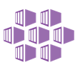
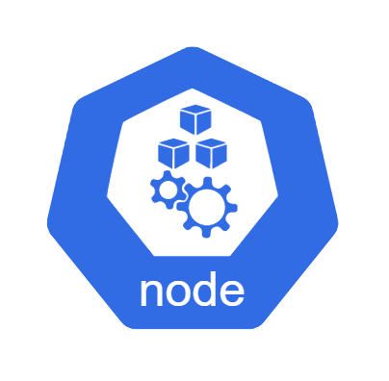
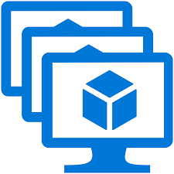


AKS High Availability Diagram (With Multiple Nodepool)
AKS Cluster
Availability Zone 1
Availability Zone 2
Availability Zone 3
VMSS
Kubelet
Kubelet
Kubelet
Kubelet
...
Docker
Kubelet
...
Docker
Kubelet
...
Docker
Docker
Docker
Docker
System/User
Nodepool
Kube-Proxy
Kube-Proxy
Kube-Proxy
Kube-Proxy
Kube-Proxy
Kube-Proxy
Nodepool
ZRS Replication
...
...
VMSS
Kubelet
Kubelet
Kubelet
Kubelet
...
Docker
Kubelet
...
Docker
Kubelet
...
Docker
System/User
Nodepool
Docker
Docker
Docker
Kube-Proxy
Kube-Proxy
Kube-Proxy
Kube-Proxy
Kube-Proxy
Kube-Proxy
Nodepool
ZRS Replication

Slide 38
AKS Disaster Recovery
Below are some of the major parameters when it comes to DR. We need to get those details and need to design the DR
Multiple type of DR set up can be implement for Disaster recovery
hot/hot → This is active-active model request will be sent to both the primary and DR regions
hot/warm → This is active-passive model we can have minimum infra and data component available in secondary. At the time of disaster, the traffic change and some component setup will be done using scripts.
hot/cold → We will not have or very minimum setup in DR region. Normally we create the environment at the time of disaster and data will be restored from backup
Azure Region | Description
Primary Region | Primary location where the environment setup
Secondary Region | Normally it is Paired region
RTO | Maximum downtime accepted to bring the secondary region up
RPO | Maximum time of data loss accepted
Design Decision
Recommended option is using hot/warm model.
Note1: Individual application designs need to state minimum number of pods required in the secondary region for running core services

Slide 39



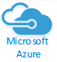

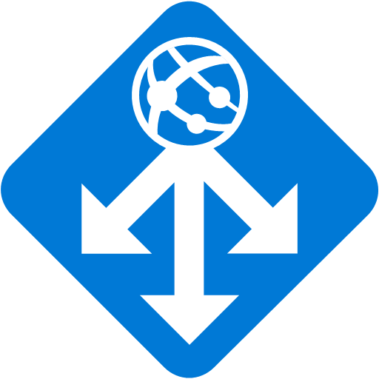

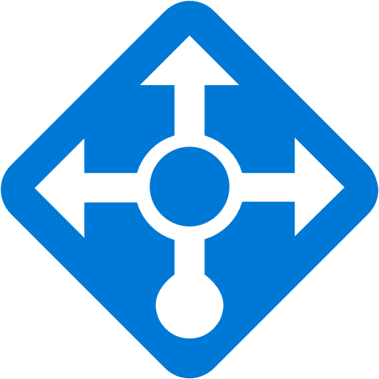

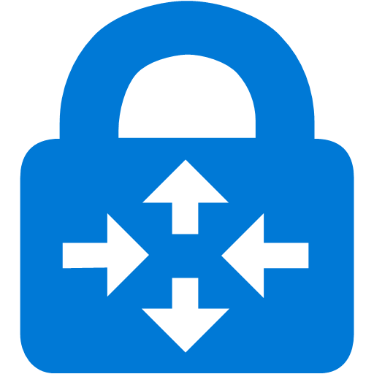

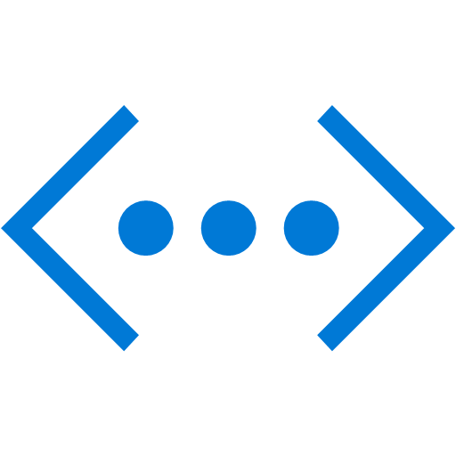



AKS Disaster Recovery
Intranet Connection through S2S
Primary flow
Internet Connection through internet
DR Flow
HUB-PRD-01
SITE-PRD-02
External Users
SN-M01-PRD-AppGWExt-01
SN-M01-PRD-EXTFWFend-01
AKS-Subnet
External public prod URLs
AGW-EXTPRD-M01-PRD-S01-001
Tier: WAF V2
NorthSouthFirewall
D4s v3(4C/16GB)
Security Firewall – R80.30
ILB
AKS
SN-M01-PRD-EXTFWBend-01(10.108.1.32/27)
Europe North
UDR redirect through firewall
UDR redirect through firewall
PEND-Subnet
Frontdoor
SN-M01-PRD-INTFWFend01
GatewaySubne
EastWestFirewall
D4s v3(4C/16GB)
Security Firewall – R80.30
PEND-NIC
ER-Dublin-M01-Gateway-S01
SKU: ErGW1Az
VN-M01-PRD-N01-S02
SN-M01-PRD-EXTFWBend-01
On-Premises
UDR redirect through firewall
UDR redirect through firewall
Express Route
VN-M01-PRD-N01-S01
SN-M04-PRD-EXTFWFend-01
SITE-DR-05
DNS Resolution
A record Decide where to redirect
SN-M04-PRD-AppGWExt-01(10.107.8.0/24)
NorthSouthFirewall
D4s v3(4C/16GB)
Security Firewall – R80.30
AGW-EXTPRD-M01-PRD-S01-001
Tier: WAF V2
PEND-Subnet
Europe West
SN-M04-PRD-EXTFWBend-01
Internal Private prod URLs
UDR redirect through firewall
UDR redirect through firewall
PEND-NIC
Express Route
SN-M04-PRD-INTFWFend-01
EastWestFirewall
D4s v3(4C/16GB)
Security Firewall – R80.30
AKS-Subnet
SLA Internal User
GatewaySubne(10.107.0.0/27)
ER-Amsterdam-M04-Gateway-S01
SKU: ErGW1Az
SN-M04-PRD-INTFWBend-01
AAG
AKS
UDR redirect through firewall
UDR redirect through firewall
VN-M01-PRD-N01-S01
VN-M04-DR-N01-S06

Slide 40
Component wise DR Setup Recommendation
Component | DR Option
Network and Subnet | Create all the Network and Subnets with NSG and UDR in the provisioning state itself.
AKS Cluster | New cluster will be hosted in Secondary region Each Node pool VM count be with single VM on warm state. At the time of DR we can match with primary count
Traffic Management | Internet – FrontDoor with priority option is used for traffic flow between Primary and DR Intranet – In AD we need to setup where the request should go Default point to primary region At the time of disaster, we need to change the A Record entry
Persistence Storage | Use suitable Azure PaaS services which already have DR option Avoid to use Azure Storage as much as possible
File share | Use RA-GRS
Azure Container Registry | Use the Premium Tier with Replication to secondary region
AKS Application Component | When ever a deployment happens in primary region same need to be happen in the DR region with the right Configuration Settings.
Azure Data Component | Use Native replication setup

Slide 41
AKS Backup
In AKS there is no need to take backup of compute resources. This means any VM components, OS Disk, NSG, Load Balancers are created by IaC. All the configuration changes are happening through Terraform Scrips. So no need to take backup of these resources.
The data related resources that need to be backed up with there native or third-party backup methods.
Component | Backup Method | Owner
AKS Cluster Setup | IaC Script. Need to rerun the script | Infra Run Team
Network Component | IaC Script. Need to rerun the script | Infra Run Team
Persistent Storage disk | Snapshot or any third-party solution (Next page have detail options) | Application team
Any PaaS Data Component (E.g. Azure SQL) | As per the PaaS Component Strategic Design | Application Team
Third-party Data Components | Native backup of the product | Application Team
Design Decision
There is no need for backup for Infra and Network components. IaC will be used for recovery process.
For all the data component the application team backup need to take care in the solution architecture

Slide 42
Backup Persistence Storage
If applications store and consume data on persisted disks or in files, we need to take regular backups or snapshots of that data. Below are the backup options.
Snapshot – We cannot backup along with the cluster. We need to do most of the task manual to recover the disk.
We need to make sure snapshot are taken properly using custom scripts
Need to restore and attach it with cluster
Third party (Velero and etc) – To take backup along with cluster we can user this. This is having more control.
Azure Backup – AKS cluster persistent volume backup is in Private preview.
We can configure backup for the persistent volumes of stateful application deployed on the AKS cluster.
We can restore back one or more persistent volumes on to the same or different cluster

Slide 43
AKS Sizing

Slide 44
AKS Recommended VM Sizing
Data Points | Large VM | Small/Medium VM
Control plane overhead - each node will have to run certain control plane pods for cluster operation | Less overhead | Huge overhead
Reserved Resource Capacity in the Nodes (% of reserved capacity will get decrease when VM size increase) - Resource utilization | Reserved capacity is less. High resource utilization | Reserved capacity is high. Lower resource utilization
Amount of data disks that each VM size can hold. (If we are using PV in a greater number of Pods.) | Bigger VM size support to mount a greater number of disk | We can mount only less number of disk
Scalability efficient (For horizontal scaling normally small VMs are efficient in cost perspective) | Make overprovisioning sometimes (Large scaling increments) | Good fit for effective horizontal scaling in cost perspective
Node failure Affecting Existing Resources | One node failure affects huge % of capacity (In 2-node cluster one node failure affect 50% of cluster capacity) | Only smaller workload (Cluster Capacity) get affected. Limited blast radius.
Base setup Cost. (In production minimum we need 3 VMs in 3 Available Sets) | High | Low
Replications (Across Multiple nodes) | Limited replication across nodes | High replication across nodes
Use Case | Cluster would grow too large, and growth is Rapid | Cluster is small and growth is normal

Slide 45
AKS System DaemonSet Pods
The Demonset make sure one pod deploy in each and every nodes. In AKS setup some DaemonSets comes as default and some of them need to be installed to achieve important task.
DaemonSet Pods comes as default:
Yellow color are defined as empty but in one of the deployment we got the mentioned values. These values are not added in the Total because we are not sure about that.
Default Pods | Description | CPU Req | Mem Req | CPU Limit | Mem Limit
azure-ip-masq-agent | Used for configures iptables rules to mask the IPs | 100m | 50Mi | 500m | 250Mi
cloud-node-manager | Responsible for updating Node objects. | 50m | 50Mi | 2000m | 512Mi
csi-azuredisk-node | The Kubernetes implementation of the Disk Container Storage Interface (CSI). 3 Container azuredisk, node-driver-registrar, liveness-probe | (10+10+10)m | (20+20+20)Mi | -(1900+1900+1900) | (200+100+100)Mi
csi-azurefile-node | The Kubernetes implementation of the File Share Container Storage Interface (CSI). 3 Container azurefile, node-driver-registrar, liveness-probe | (10+10+10)m | (20+20+20)Mi | - (1900+1900+1900) | (400+100+100)Mi
kube-proxy | It is a network proxy that runs on each node. 2 Container kube-proxy-setctmax | (100+100)m | - (0+265)Mi | - (1900+100) | - 4.46Gi + 265Mi

Slide 46
AKS System DaemonSet Pods
DaemonSet Pods comes when we Install mandatory components
Total:
Default Pods | Description | CPU Req | Mem Req | CPU Limit | Mem Limit
azure-npm | Azure Network Policy | 250m | 300Mi | 250m | 300Mi
omsagent | Omsagent and omsagent-prometheus | (75+75)m | (325+225)Mi | (500+500)m | 750Mi+1Gi
aks-secrets-store-csi-drivers | AKS Secret Three container (liveness-probe, node-driver-registrar, Secrets-store) | (10+10+50)m | (20+20+100)Mi | (100+_+200)m | (100+100+200)Mi
aks-secrets-store-provider-azure | AKS Secret | 10m | 20Mi |  | 100Mi
microsoft-defender-collector-ds | MS Defender. Two Container (Low-level-init & ) | (30+30)m | (32+32) Mi | (60+150)m | (64+64) Mi
microsoft-defender-publisher-ds | MS Defender | 30m | 32Mi | 60m | 200Mi
CPU Req | Mem Req | CPU Limit | Mem Limit | Total Pods
780 m | 940Mi | >4260m (5000) | 4650Mi | 11

Slide 47
AKS System Pod Capacity
AKS automatically install some system Pods in one or more Nodes (Not in all the nodes). When we install components like monitor, Network policy some pods will be added automatically in one or some nodes.
System Pods comes as default:
Default Pods | Description | CPU Req | Mem Req | CPU Limit | Mem Limit
coredns-autoscaler | Used to scale up/down the CoreDNS. Max 1 Pod | 20m | 10Mi | 200m | 500Mi
coredns | Serve as the Kubernetes cluster DNS. >= 1 pod | 100m | 70Mi | 3000m | 500Mi
konnectivity-agent | Provides a TCP level proxy for the control plane to cluster communication .>=1 pod | 20m | 20Mi | 256m | 128Mi
metrics-server | Collects resource metrics from Kubelets and exposes them in Kubernetes apiserver. Max 1 pod | 44m | 55Mi | 1000m | 2000Mi

Slide 48
AKS System Pod Capacity
System Pods comes when we Install mandatory components:
Total:
Default Pods | Description | CPU Req | Mem Req | CPU Limit | Mem Limit
ingress-appgw-deployment | Application Gateway Ingress Controller | 100m | 20Mi | 700m | 300Mi
omsagent-rs-ffcdbbdff-sbxns | Container insights agent ReplicaSet Pods | 150m | 250Mi | 1000m | 1Gi
microsoft-defender-collector-misc | MS Defender | 30m | 32Mi | 60m | 64Mi
gatekeeper-controller | For Azure Policy | 100m | 256Mi | 2000m | 2Gi
gatekeeper-audit | For Azure Policy | 100m | 256Mi | 2000m | 3Gi
azure-policy | For Azure Policy | 30m | 50Mi | 100m | 200Mi
azure-policy-webhook | For Azure Policy | 30m | 50Mi | 100m | 200Mi
CPU Req | Mem Req | CPU Limit | Mem Limit
724 | 1057Mi | 10416m | 9916Mi

Slide 49
Azure CNI Network IP Sizing
In the Azure CNI each pod Ips will be taken from the Subnet. Calculating the IP Ranges in advanced is important to avoid insufficient Ips in future.
During the VM creation Pod IP range get allocate. Below is an example for reserved IP calculation for one VM in CNI.
Max Pod Count = 30
VM Gets one IP = 1
Total IP reserved = 31 (VM count + Max Pod Count)
Azure Application Gateway (AAG) IP address – 1
Internal Loadbalancer (ILB) Ip Address - default 1 (May need to according to application expose outside)
Reserved IP in Network - 5
Total Number of IPs required for a cluster is (n+1) + (n+1) * Max Number of pods + AAG IPs + ILB IPs + Reserved IPs
n is number of VMs
(n+1) → says total number of vm ips
(n+1) * Max Number of pods → says Pod Ips
1 more node will be automatically created during cluster update, so we are adding 1 node extra.
Example for 2 nodes the total IP is → 2 + 2*30 + 1 + 1 + 5 = 69 //Max pod count is 30
All the system pods are also included in the MaxPods count.

Slide 50
AKS Reserved Resource
AKS reserves resources on each node. As a node grows larger in resources, the resource reservation grows due to a higher need for management of user-deployed pods.
The Main Two types of resources reserved are :
CPU – In AKS each core can be represent in Millicores. 1 core is equal to 1000 Millicores.
Memory - Memory utilized by AKS includes the sum of two values (kubelet daemon installed all node take 750 Mi + A portion on Memory Allocated ).
CPU cores on host | 1 | 2 | 4 | 8 | 16 | 32 | 64
Kube-reserved (millicores) | 60 | 100 | 140 | 180 | 260 | 420 | 740
Memory Range (GB) | Reserved Memory | Example for Reserved Memory in GB (Percentage of Reserved ) | Sample VM Size | Price (Month)
4 | 25% | 4 GB VM → .75 + (.25 * 4) = 1.75 GB (43.75%) | A2_v2 | £55.2157
4 to 8 | 20% | 8 GB VM → .75 + (.25 * 4) + (.2 * 4) = 2.55 GB (31.875%) | D2S_v3 | £58.2495
8 to 16 | 10% | 16 GB VM → .75 + (.25 * 4) + (.2 * 4) + (.1 * 8) = 3.35 (20.94%) | D4S_v3 | £116.4990
16 to 128 | 6% | 32 GB VM → .75 + (.25 * 4) + (.2 * 4) + (.1 * 8) + (.06 * 16) = 4.31 (13.47%) 64 GB VM → .75 + (.25 * 4) + (.2 * 4) + (.1 * 8) + (.06 * 48) = 6.23 (9.73%) 128 GB VM → .75 + (.25 * 4) + (.2 * 4) + (.1 * 8) + (.06 * 112) = 10.07 (7.87%) | D8S_v3 D16S_v3 D32S_v3 | £232.9981 £465.9962 £931.9924
> 128 | 2% | 256 GB VM → .75 + (.25 * 4) + (.2 * 4) + (.1 * 8) + (.06 * 112) + (.02 * 128)= 12.63 (4.93%) | D64S_v3 | £1,863.9847

Slide 51
AKS Workload Assumptions
Pod Capacity: Below is the Assumed pod capacity for average type of applications. This can be changed according to the SLA applications. Application team need to provide the sizing before deploying in to the AKS.
Max Pod Count – 30 / 35 according to Cluster Size
No of System Pods in each Node – 15 (11 default and 4 is reserved for any system component installation)
 |  | CPU |  | Memory
Env | Application Type | Request (Mi) | Limit (Mi) | Request (mb) | Limit (mb) | Replica
Dev/SIT | System Pods | 0.2 | 0.3 | 250 | 500 | 2
 | Services API | 0.2 | 0.3 | 500 | 1024 | 2
 | Application Pods | 0.4 | 0.5 | 800 | 1536 | 2
Pre Prod | System Pods | 0.2 | 0.5 | 250 | 750 | 2
 | Services API | 0.2 | 0.5 | 1024 | 2048 | 2
 | Application Pods | 0.4 | 0.75 | 800 | 3072 | 2
Prod | System Pods | 0.2 | 0.6 | 500 | 1024 | 3
 | Services API | 0.4 | 0.6 | 500 | 1024 | 3
 | Application Pods | 0.5 | 1 | 2048 | 4096 | 3

Slide 52
Sizing Summary
The Summary table covers the Cluster Size, CIDR, Min & Max Pod to be deployed and approximate cost.
Pod Sizing Excel : Attached the Excel with full detail.

Slide 53
AKS HA, DR & Backup

Slide 54
AKS Monitoring

Slide 55
AKS Monitoring Options
Monitoring the Kubernetes lets us see its logs, health, performance statistics such as CPU, memory, and disk usage available for both Linux and Windows nodes in the AKS Engine cluster. Proper monitoring and handling will help us to avoid any big issues in future.
Kubernetes Native monitoring - Tools like kubectl and the Kubernetes Dashboard use metrics-server, and it has an API to get metrics.
Azure resource logs - The logs for AKS control plane components are implemented in Azure as resource logs. Container insights doesn't currently use these logs, so you do need to create your own log queries to view and analyze them
Container Insights – Enable Container insights helps us to expand the above two monitoring. Container insights provides interactive views and workbooks that analyze collected data for a variety of monitoring scenarios.
Application Insight – This is used to monitor the Application hosted in AKS
External Resources – External resources are not part of AKS but they work along with AKS for example Ingress Controller (AGIC).
Monitoring extension - By embedding the extension in your Api model, the extension will do much of the work to create a monitoring solution in your cluster, which includes cAdvisor, Prometheus and Grafana.

Slide 56
Kubernetes Native monitoring
Metrics-server - Resource metrics are collected by the lightweight, in-memory metrics-server component Metrics-server. Metrics-server is part of every AKS Engine deployment. Tools like kubectl and the Kubernetes Dashboard use metrics-server, and it has an API to get metrics for your custom monitoring solution.
Kubectl top - We can retrieve compact metric snapshots from the Metrics API using kubectl top. The kubectl top command returns current CPU and memory usage for a cluster’s pods or nodes, or for a particular pod or node if specified.
Kubernetes Dashboard - This is a web-based user interface that can visualize cluster metrics. Dashboard provides resource usage breakdowns for each node and pod, as well as detailed metadata about pods, services, Deployments, and other Kubernetes objects. Unlike kubectl top, Dashboard provides not only an instantaneous snapshot of resource usage but also some basic graphs tracking how those metrics have evolved over the previous 15 minutes.
Add kube-state-metrics – This service provides additional cluster information that Metrics Server does not. Metrics Server exposes statistics about the resource utilization of Kubernetes objects, whereas kube-state-metrics listens to the Kubernetes API and generates metrics about the state of K8S objects: node status, node capacity (CPU/memory), number of desired/available/unavailable/updated replicas per Deployment, pod status (e.g., waiting, running, ready), and so on.
logs - Troubleshooting a problem may require more detailed information and application-specific context, which is where logs can come in handy. The kubectl logs command dumps or streams logs written to stdout from a specific pod or container. --tail flag lets restrict the output to a specified number of the most recent log messages.

Slide 57
Azure resource logs
Azure resource logs are platform logs that provide insight into operations that were performed within an Azure resource. Resource logs aren't collected by default. This resource Logs can describe in the diagnostic setting for send its resource logs to different destinations say Azure Storage, Azure Log Analytics and Event Hub. The following are the logs for AKS control plane components.
Category | Description
kube-apiserver | Logs from the API server.
kube-audit | Audit log data for every audit event including get, list, create, update, delete, patch, and post.
kube-audit-admin | Subset of the kube-audit log category. Excluding the get and list audit events from the log.
kube-controller-manager | Gain deeper visibility of issues that may arise between Kubernetes and the Azure control plane
kube-scheduler | Logs from the scheduler.
cluster-autoscaler | Understand why the AKS cluster is scaling up or down, which may not be expected.
cloud-controller-manager | Logs from the cloud-node-manager component of the Kubernetes cloud controller manager.
guard | Managed Azure Active Directory and Azure RBAC audits. For managed Azure AD, this includes token in and user info out. For Azure RBAC, this includes access reviews in and out.
csi-azuredisk-controller | Logs from the Azure Disk CSI storage driver.
csi-azurefile-controller | Logs from the Azure Files CSI storage driver.
csi-snapshot-controller | Logs from the Azure CSI driver snapshot controller.
AllMetrics | Includes all platform metrics.

Slide 58
Kubernetes Container Insights
AKS generates platform metrics and resource logs, like any other Azure resource, that you can use to monitor its basic health and performance. Enable Container insights to expand on this monitoring. Container insights is a feature in Azure Monitor that monitors the health and performance of managed Kubernetes clusters hosted on AKS in addition to other cluster configurations. Container insights provides interactive views and workbooks that analyze collected data for a variety of monitoring scenarios.
Application Insight can be used to monitor below areas
Cluster level components
Kubernetes objects and workloads
Cluster level components - Use existing views and reports in Container Insights to monitor cluster level components. The Cluster view gives you a quick view of the performance of the nodes in your cluster including their CPU and memory utilization. Use the Nodes view to view the health of each node. Use Node workbooks in Container Insights to analyze disk capacity and IO in addition to GPU usage
Kubernetes objects and workloads - Use existing views and reports in Container Insights to monitor containers and pods. Use the Nodes and Controllers views to view the health and performance of the pods running on them and drill down to the health and performance of their containers. View the health and performance for containers directly from the Containers view. Use the Deployment workbook in Container insights to view metrics collected for deployments.
Deployments view in Container insights is currently in public preview.

Slide 59
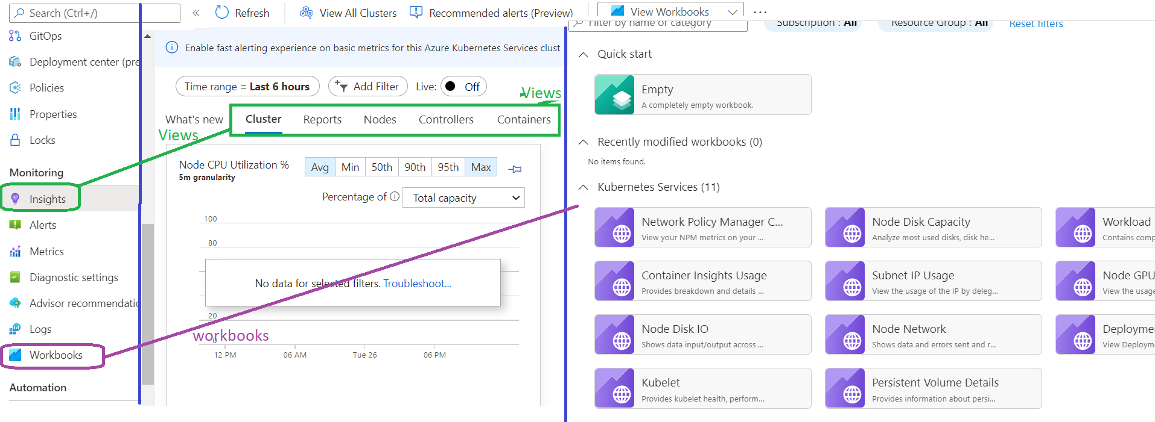
Kubernetes Container Insights
Views and Workbooks can be Access then menus Insights and Workbooks respectively.
Live data - In troubleshooting scenarios, Container insights provides access to live AKS container logs (stdout/stderror), events, and pod metrics. See How to view Kubernetes logs, events, and pod metrics in real-time for details on using this feature.

Slide 60
Application Insight
Monitor microservice application deployments to identify application failures and latency issues. Includes such information as request rates, response times, and exceptions.
The application level includes the application workloads running in the AKS cluster can be monitored through the Azure Application Insight. Application Insights provides complete monitoring of applications running on AKS and other environments.
Java application, can provide monitoring without instrumenting any code in to it
Other application need SDK for enable monitoring
For complete monitoring in Java we need code-based monitoring
Design Decision
Each application will have its own Application Insight. Each application need to monitor the application with there individual application insights.

Slide 61
Kubernetes Monitoring For External Resources
AKS not solve all the solution we need to integrate the third party components for some particular purpose. Some of the components external to AKS are listed below.
Ingress – Ingress controller are third party and AGIC is one of the MS supported Ingress
Egress – For egress control we can use Load balancer or UDR to control that
Service Mesh - Used to control connectivity between the services.
Other Azure PaaS - Azure SQL, Redis Cache and etc.
Design Decision
We need to use the components Native monitoring and need to do a design to integrate it with out existing solution on need basis.
Most of the Azure components already Having monitoring Solution. For example AAG, LB. Redis Cache are already having its monitoring solution in SLA.

Slide 62
Monitoring extension
By embedding the extension in your Api model, the extension will do much of the work to create a monitoring solution in the cluster, which includes cAdvisor, Prometheus and Grafana.
Prometheus is a popular open source metric monitoring solution and is a part of the Cloud Native Compute Foundation. Container insights provides a seamless onboarding experience to collect Prometheus metrics. Typically, to use Prometheus, you need to set up and manage a Prometheus server with a store. By integrating with Azure Monitor, a Prometheus server is not required.
We often needs metrics from the applications. In Kubernetes normal standard to gather application metrics is Prometheus.
Most applications in Kubernetes cluster will expose their metrics via an endpoint compatible with Prometheus scraping.
If this is not the case (legacy applications), we can rely on exporters to bring that functionality.
Configuring the scraping of Prometheus endpoints occurs through the setup of a ConfigMap for the Log Analytics agent.
There are 3 ways to configure data collection:
Using pod annotation (cluster-wide)
Specifying an array of Kubernetes service (cluster-wide)
Specifying an array of URLs (per node and/or cluster-wide)

Slide 63


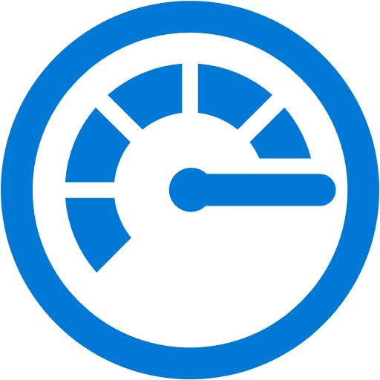

Monitoring extension - AKS Prometheus Scrapping
Node
Endpoint (URL/IP)
http://url:9101/metrics
Cluster
Grafana
Endpoint (Pod Annotation)
prometheus.io/scrape: "true"
prometheus.io/path: "/mymetrics"
prometheus.io/port: "8000"
prometheus.io/scheme: "http"
KQL
Query
Log Analytics Agent
Azure Monitor for Container
Log Analytics
Pods
Endpoint (Kubernetes Services)
http://my-service-dns.my-namespace:9100/metrics
https://metrics-server.kube-system.svc.cluster.local/metrics​
Azure Dashboard

Slide 64
Monitoring extension – CI Prometheus Scrapping vs Prometheus Service
Description | Container Insight – Scrapping | Prometheus Service
Additional Resources for collecting and storing the metrics | Not Required metrics will be stored in Log Analytics | Need additional services need to be deploy for collecting and storing the metrics.
Query the metrics | KQL (Kusto Query Language) – No leaning of new query language. Cannot re-use work that could have been already done | Support only PromQL – Need to learn but re-use the existing queries
Cost | Log Analytics data collection is High | We need to spend only for resources to run Prometheus related components.
Performance | Some delay between the moment the metrics are collected and the time they are effectively available in the Log Analytics workspace | The latency between data collection is low.
Feature Compatibility | lack some flexibility in how data can be collected (some settings are cluster-wide only). | Fully Supported
Support | Microsoft Supported | Not supported by Microsoft

Slide 65
AKS Monitoring Comparison
Description | AKS Native Metrics | Azure Container Insight | Prometheus Scraping
Definition | It is an inbuild feature no need to setup any think. The metrics are stored in one of the Worker Node’s In-Memory. No persistence Storage, | Azure Native Monitoring solution. This need to be integrate with Azure Log Analytics. It’s persistence storage and give good dashboard for analyzing the monitoring details | Using Container insights to expose the Prometheus metrics endpoint through exporters or pods and the containerized agent for Container insights can scrape the metrics.
Coverage / Use Case | Only Basic metrics and logs are covered | Mostly all the important area are covered. We can see Node, Kubernetes objects and workload. | It gives vast area of monitoring and sync with industry standard
Dashboard | Using the AKS Dashboard, we can see the charts for last 15 Min | Give Rich Chart support using the Azure Dashboard | We can display in both Azure Dashboard and Grafana.
Cost | Low | Medium | High
Complexity | Easy to configure and management is complex | Easy to configure and manage | Complex setup easy to manage
Azure Support | MS Supported | MS Supported | MS Supported
Ref URL | https://www.datadoghq.com/blog/how-to-collect-and-graph-kubernetes-metrics/ | https://docs.microsoft.com/en-us/azure/aks/monitor-aks | https://docs.microsoft.com/en-us/azure/azure-monitor/containers/container-insights-prometheus-integration https://blog.seblab.be/posts/scraping-prometheus-metrics-from-aks-to-azure-monitor/

Slide 66
Kubernetes Monitoring options
Category | Description | SLA Option
Cluster Level Components | AKS Nodes and Node Pools (VMSS) | The Container Insight’s Cluster view gives you a quick view of the performance of the nodes in the cluster including their CPU and memory utilization. Use the Nodes view to view the health of each node in addition to the health and performance of the pods running on each.
Managed AKS Component | AKS Control Plane components – API Servers, cloud Controllers, Kubelet | Azure Monitor and container insights don't yet provide full monitoring for the API server. We can use metrics explorer to view the Inflight Requests counter, but you should refer to metrics in Prometheus for a complete view of API Server performance.
Kubernetes objects and workload | Kubernetes objects – Deployments, Pods, Containers, Replicaset and etc. | Use existing views and reports in Container Insights to monitor containers and pods.
Applications | Application workload | Application Insights provides complete monitoring of applications running on AKS.
External to AKS | External resource but not part of AKS but work along with AKS – AAG, etc. | Monitor external components such as Service Mesh, Ingress, Egress with Prometheus and Grafana or other proprietary tools.

Slide 67
AKS Monitoring Design Decision
Design Decision
Container Insight covers most of the monitoring area. So, we consider enabling Container Insight in the Cluster. This will take care of monitoring the nodes and the AKS objects like Containers, Pods, Deployments and etc.
Design Decision
Application monitoring will be handled using Application insight but the respective application team
Design Decision
Dependent Azure components like ingress, egress and etc. are covered in the existing Green Field Foundation Setup.
Below are cover during the strategic design
New PaaS service which integrate with AKS.
Any third-party component integration we need to really on its native Monitoring

Slide 68
AKS Monitoring Alert
Alert on system resource triggers when they are experiencing peak demand and running near capacity, with Container insights you would create a log alert based on performance data stored in Azure Monitor Logs. Container insights now includes pre-configured metric alert rules for your AKS and Azure Arc-enabled Kubernetes cluster, which is in public preview.
We cannot use the metrics alert as per the SLA design. We need to push all the alert to Log Analytics and then we need to trigger alerts as per SLA Standard. Container Insight also pushing all the metrics to Log Analytics. We need to work on writing Kusto Query (KQL) for implementing below alerts.
Azure Alert Name | Target | Description | Azure Severity | Threshold
Average container CPU % | Node | Calculates average CPU used per container. | 2 | >95%
Average CPU % | Pod | Calculates average CPU used per node. | 2 | >80%
Average container working set memory % | Node | Calculates average working set memory used per container | 2 | >95%
Average Working set memory % | Pod | Calculates average Working set memory for a node. | 2 | >80%
Average Disk Usage % | Node | Calculates average disk usage for a node. | 2 | >80%
Average Persistent Volume Usage % | Pod | Calculates average PV usage per pod. | 2 | >80%
Restarting container count | Pod | Calculates number of restarting containers | 2 | >0
Failed Pod Counts | Pod | Calculates if any pod in failed state. | 2 | >0
Node NotReady status | Node | Calculates if any node is in NotReady state. | 2 | >0
Pods ready % | Node | Calculates the average ready state of pods. | 2 | <80%

Slide 69
AKS Security

Slide 70
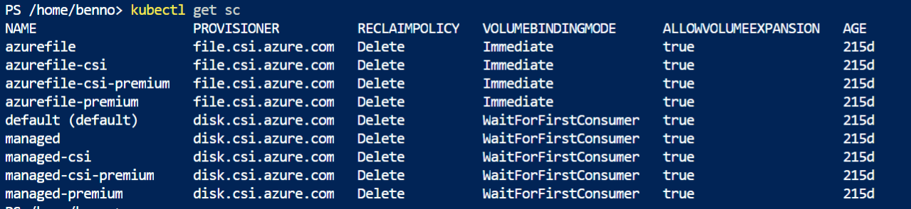
Azure RBAC
RBAC
How RBAC works

Slide 71
AKS RBAC
RBAC
How RBAC works

Slide 72
Pod Managed Identity
RBAC
How RBAC works

Slide 73
AKS Upgrade

Slide 74
Kubernetes versions
AKS cluster lifecycle involves performing periodic upgrades to the latest Kubernetes version. It’s important to apply the latest security releases, or upgrade to get the latest AKS features. The Kubernetes community releases minor versions roughly every three months.
Minor version releases include new features and improvements.
Patch releases are more frequent (sometimes weekly) and are intended for critical bug fixes within a minor version.
Patch releases include fixes for security vulnerabilities or major bugs.
Kubernetes uses the standard “semantic versioning” versioning scheme for each version.\
[major].[minor].[patch]
Example: 1.17.7, 1.17.8
Major versions change when incompatible API updates or backwards compatibility may be broken.
Minor versions change when functionality updates are made that are backwards compatible to the other minor releases.
Patch versions change when backwards-compatible bug fixes are made.

Slide 75
Release and deprecation process
Customer can reference upcoming version releases and deprecations on the AKS Kubernetes Calendar
Release update to client
The AKS team publishes pre-announcements with planned dates of the new Kubernetes versions in below ways.
Azure documentation,
GITHUB
Emails to subscription administrators who own clusters that are going to fall out of support.
Azure Advisor
K8s version | Upstream release | AKS preview | AKS GA | End of life
1.20 | Dec-08-20 | Jan 2021 | Mar 2021 | 1.23 GA
1.21 | Apr-08-21 | May 2021 | Jul 2021 | 1.24 GA
1.22 | Aug-04-21 | Sept 2021 | Dec 2021 | 1.25 GA
1.23 | Dec 2021 | Jan 2022 | Apr 2022 | 1.26 GA
1.24 | Apr-22-22 | May 2022 | Jul 2022 | 1.27 GA
1.25 | Aug 2022 | Sept 2022 | Nov 2022 | 1.28 GA

Slide 76
Upgrade Steps
Steps | Commands and Descritions
Check for available AKS cluster upgrades | az aks get-upgrades --resource-group <rgname> --name <clustername> --output table Example output Name ResourceGroup MasterVersion Upgrades -------- --------------------- ------------------- -------------- default myResourceGroup 1.18.10 1.19.1, 1.19.3
Upgrade an AKS cluster | az aks upgrade --resource-group <rg> --name <clustername> --kubernetes-version <version> During the upgrade process, AKS will: Add a new buffer node to the cluster that runs the specified Kubernetes version. “cordon and drain“ one of the old nodes to minimize disruption to running applications. When the old node is fully drained, it will be reimaged to receive the new version and it will become the buffer node for the following node to be upgraded. This process repeats until all nodes in the cluster have been upgraded. At the end of the process, the last buffer node will be deleted, maintaining the existing agent node count and zone balance.
Azure Kubernetes Service (AKS) node image upgrade | To Verify Latest Node/Nodepool Version az aks nodepool get-upgrades --nodepool-name <nodepool> --cluster-name <clustername> --resource-group <rg> To Check the current node image version az aks nodepool show --resource-group myResourceGroup -cluster-name myAKSCluster --name mynodepool --query nodeImageVersion Upgrade all nodes in all node pools az aks upgrade --resource-group <rgname> --name <clustername> --node-image-only

Slide 77
AKS IaC – Repo & Automation

Slide 78
AKS Infra Deployment Configuration Overview
Resources | Configurations
Azure VNet | One Subnet for AKS One Subnet for Application Gateway
Azure Container Registry | Standard Tier for Hosting Container Images
Azure Application Gateway | Standard_v2 tier Private frontend ip configured from the deployed subnet above http listener configured with port 80
Azure KeyVault | Acting as a Secret provider for AKS Cluster
AKS Cluster | RBAC Authentication enabled Default Node pool with 2 Nodes Auto Scaling Disabled Nodes Deployed on Private Subnet deployed above Create User assigned identity and assign to AKS cluster Azure Key vault configured as secret provider Azure CNI Network Plugin Add AKS Cluster identity to Container Registry with AcrPull Permissions Integrate deployed Application Gateway as ingress controller for the AKS Cluster Add the Ingress Controller identity to the Application Gateway resource group with contributor permissions
Azure SQL DB ( Not part of AKS Infra , required for the Demo Application) | For Hosting Data of the Deployed Application On AKS Deploy an Azure SQL Server Deploy an Azure SQL DB Add a Firewall rule for the AKS Subnet on the SQL Server Add a Firewall rule for the machine which executes terraform script Initialize SQL DB with a SQL query

Slide 79





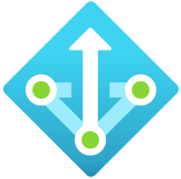

Deployment Diagram Infra
Terraform Infra Deployment
AKS VNET
AKS Node-Pod Subnet
App Gateway Subnet
DevOps
Pipeline
AKS Cluster
Azure Repo
Public IP
Frontend
AKS Node pool
Application Gateway
Terraform modules
Terraform Tasks
Azure
Container Registry

Slide 80
AKS Infra Deployment Configuration Overview
Employee Application Overview
3 tier application consists of Web, API & Database Layer
Web & API Applications are built on Dotnet,
Application & Docker files are hosted on Azure Repo
Azure SQL is used as Database for the application
Employee Application CI/CD pipeline overview
Service Connection for AKS Cluster & Container Registries are created on DevOps as a one-time task
Docker Tasks are used to Create docker images for Web & API apps separately and push the image to Azure Container registry
Azure Build Number variable is used as an image tag
Kubectl task to Create a Config map for the Api application to configure the Azure SQL Database connection string
Kubectl task to Create a deployment for the API Application Pods referencing the Config Map and the image built on ACR
Kubectl task to Create a Service for the API Application
Kubectl task to Create a Config map for the Web application which contains the Service URL for the API Application
Kubectl task to Create a deployment for the Web Application Pods referencing the Config Map and the image built on ACR
Kubectl task to Create a Service for the Web Application
Kubectl task to create an Ingress Controller configuration to map the Web Application Service to Application Gateway Ingress Controller;

Slide 81

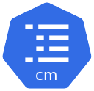


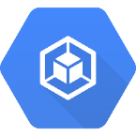


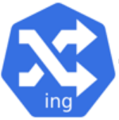
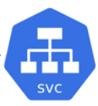


Deployment Diagram Apps
AKS Cluster
Node Pool
Emp Web
App Setting
Emp API
App Setting
Docker Push
ACR
EMP App
Images
CI/CD
Pipeline
Emp App
Repo
Users
Application
Gateway
Ingress
Controller
Cluster IP
Emp
Web Tier
Cluster IP
Emp
API Tier
Emp DB
Emp Deployment
Web Tier
Emp Deployment
API Tier
Key Vault
Secrets

Slide 82
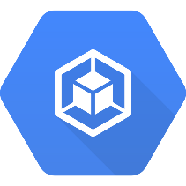
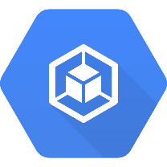
Infra IaC Steps
Docker Task
Azure
Container Registry
Image Version
variable
using build number
AKS Cluster
Pods
Application
Gateway
POD /Deployment
Kubectl task
DevOps
Pipeline
Azure Repo
Service
(ClusterIP)
Kubectl task
Service
Ingress
Kubectl task
ingress

Slide 83
Helm vs kubectl
Helm | kubectl
Package Manager for managing application | Command line tool for configuring Kubernetes environment
More preferred on microservice architecture | Preferred for simple deployments
HELM uses multiple Kubernetes manifest files to create a package named as Chart, which is used for deployment | Kubectl uses single Yaml Kubernetes manifest files to deploy Kubernetes components
Parameterizing of Deployment available specific to application is simple | Env parameter has to be used inside yaml to update the same
Manages previous versions for easier rollback | Not available
HELM is by default available on AKS Linux nodes and not available on AKS Windows nodes https://docs.microsoft.com/en-us/azure/aks/kubernetes-helm#before-you-begin | Kubectl is available by default on all AKS nodes
Supported on both Windows & Linux Clients | Supported on both Windows & Linux Clients

Slide 84
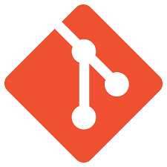


Repo Folder Structure
emp.sln
SimpleEmp
TerraformScripts
Pipelines
emp
Modules
Templates
Project Folders
Storage
ExeSimpleTerraform.yaml
…
ExeSimpleTFApply.yaml
AzureStorage
ExeSimpleTFPlan.yaml
Project Folders
Storage.tf
TestProjects
Project Files
variables.tf
AddSubnets.yaml
…
outputs.tf
AKSProjects
Project Files
README.md
OneTierAKSEmpInfra.yaml
Dockerfile
LogAnalytics
OneTierAKSInfra2.yaml
pipelines
Network
OneTierAKSInfra3.yaml
Compute
Variable Group
Buildempcontainer.yaml
Data
Shared VG – This VG can be used in multiple pipelines
.dockerignore
Monitoring
docker-compose.override.yml
AzurePSScrips
VG_StateFile
docker-compose.yml
VG_SharedVariableGP_2
AKSProjects
…
…
ThreeTierAKS
VG_SharedVariableGP_n
emp.sln
OneTierAKS
Pipeline VG – individual VG will be create for each Pipeline
Parameters
empInfra.tfvars.json
Infra2.tfvars.json
VG_ OneTierAKSEmpInfra
main.tf
VG_ OneTierAKSInfra2
main.tf
VG_ OneTierAKSInfra3

Slide 85
AKS Other Topics

Slide 86
Resourcing
Praveen network Rail
Calico, Porworx, Prisma, Twislock

Slide 87
Thank you
CaaS Practice Team
Email

